Slide 1
TOPIC 3: FUNCTION AND OOP IN PYTHON
3.5 : USE MAGIC METHOD IN PYTHON

Slide 2
LEARNING OUTCOME
Students are able to describe magic method.
Students are able to use magic method in Python.

Slide 3
MAGIC METHOD
special methods that start and end with the double underscores.
also called dunder methods
invocation happens internally from the class on a certain action.
For example, when you add two numbers using the + operator, internally, the __add__() method will be called.

Slide 4
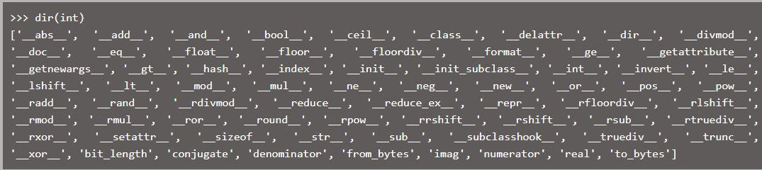
MAGIC METHOD
Built-in classes in Python define many magic methods.
Use the dir() function to see the number of magic methods inherited by a class.
For example, the following lists all the attributes and methods defined in the int class.

Slide 5
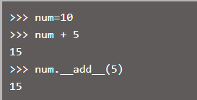
MAGIC METHOD
For example, the __add__ method is a magic method which gets called when we add two numbers using the + operator.
Consider the following example.

Slide 6
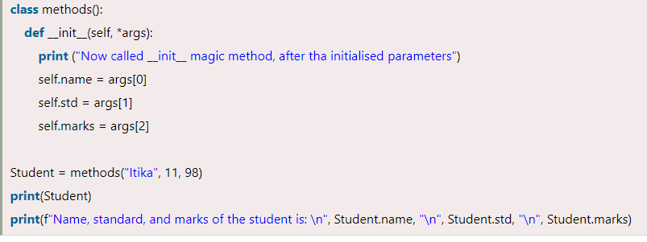
__init__() METHOD
__init__() Method
When we create an instance of the class, it is called automatically.
It’s like constructors in various programming languages like the popular ones C++, Java.
These methods are invoked after _new_ and therefore are referred to as initializing the attributes

Slide 7
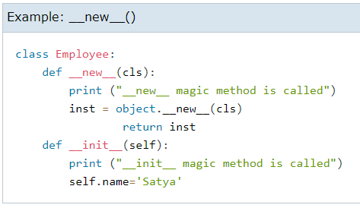
__new__() METHOD
__new__() method
Languages such as Java and C# use the new operator to create a new instance of a class.
In Python the __new__() magic method is implicitly called before the __init__() method.
The __new__() method returns a new object, which is then initialized by __init__().

Slide 8
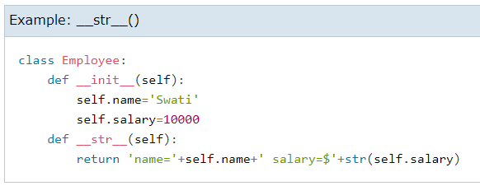
__str__() METHOD
__str__() method
Another useful magic method is __str__().
It is overridden to return a printable string representation of any user defined class.
We have seen str() built-in function which returns a string from the object parameter.
For example, str(12) returns '12'. When invoked, it calls the __str__() method in the int class.

Slide 9
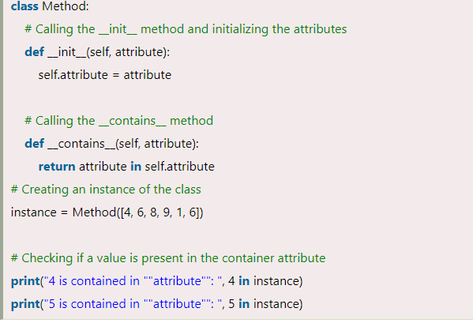
__contains__() METHOD
__contains__() Method
The 'in' membership operator of Python implicitly calls the __contains__ method.
We can use the __contains__ method to determine if an element is contained in an object's attributes.
We can use this method for attributes that are containers ( such as lists, tuples, etc.).

Slide 10
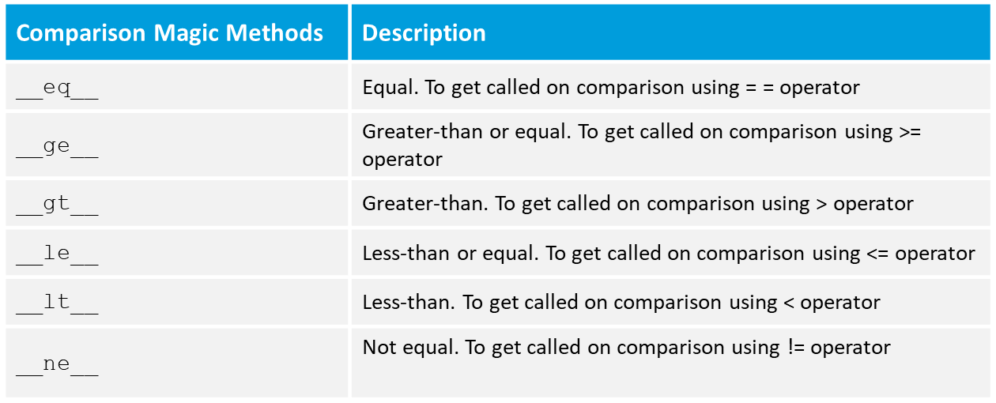
List of Comparison Methods

Slide 11
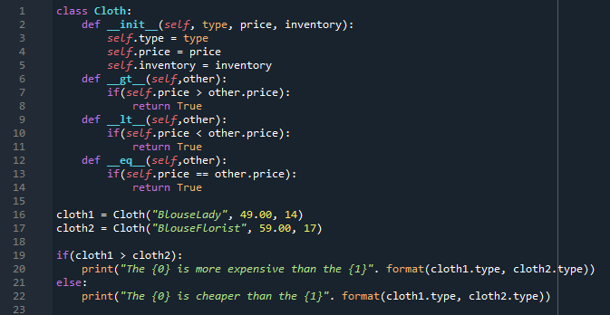
List of Comparison Methods

Slide 12
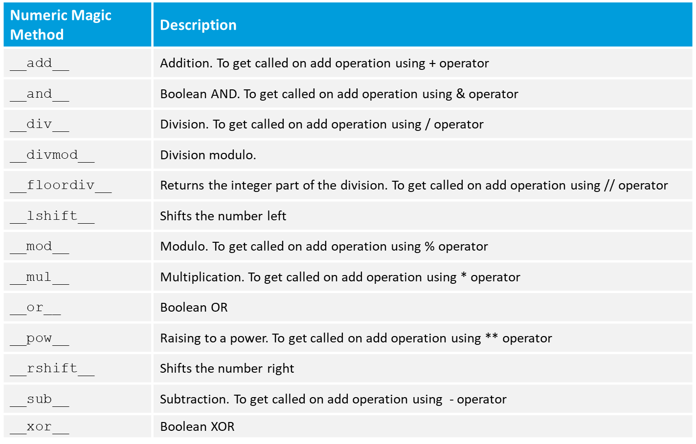
List of Numeric Methods

Slide 13
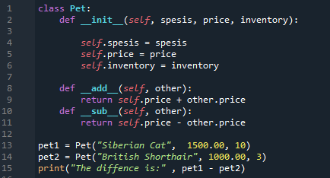
Numeric Methods

Slide 14
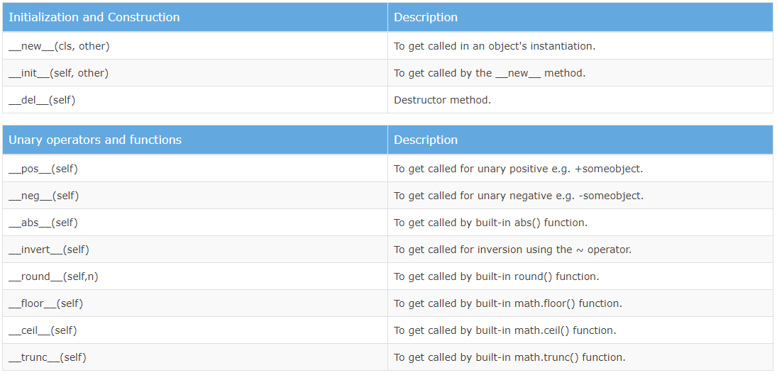
Important Magic Methods

Slide 15
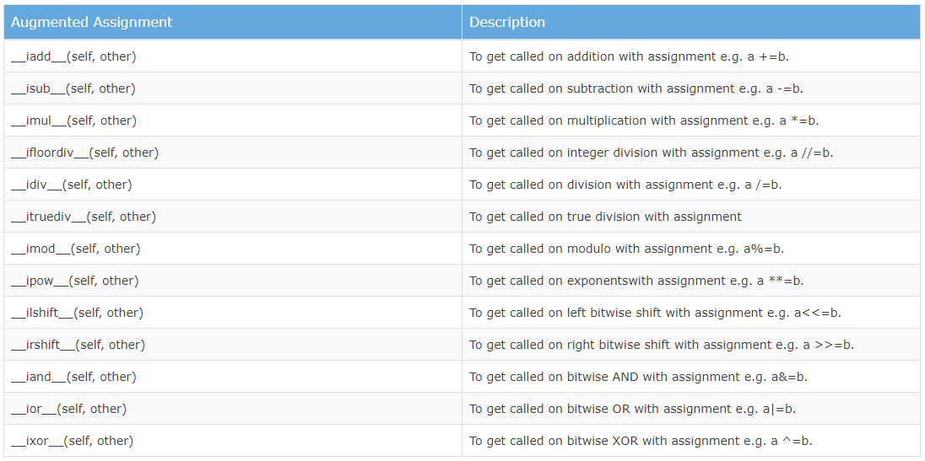
Important Magic Methods

Slide 16
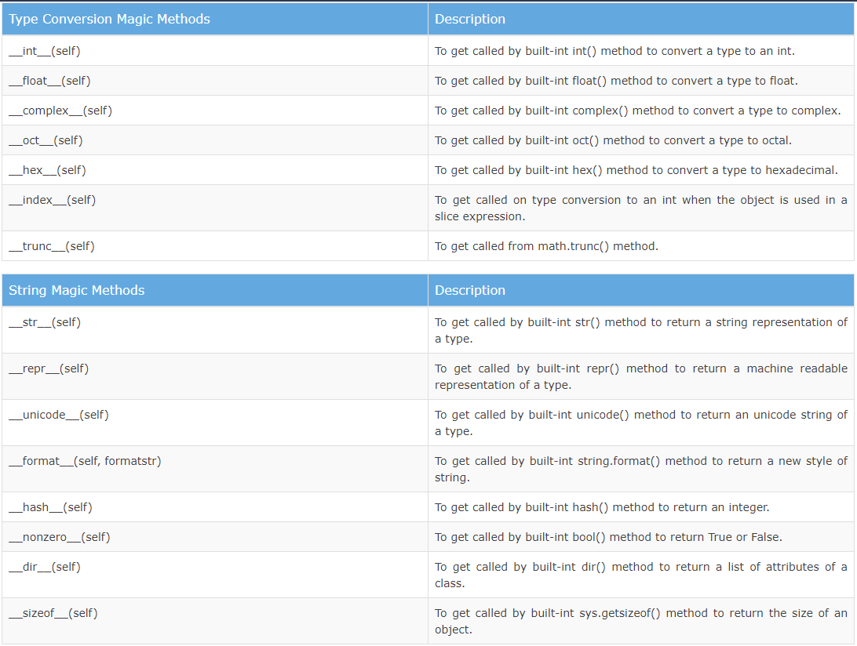
Important Magic Methods

Slide 17
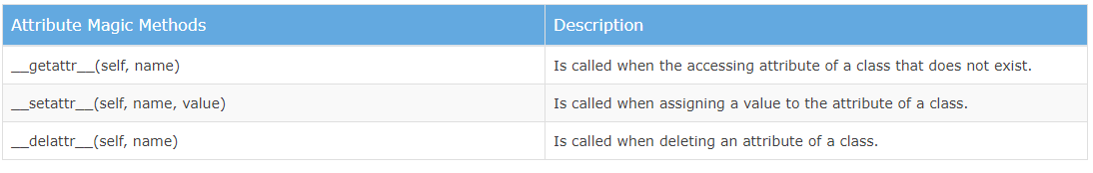
Important Magic Methods

Slide 18
Thank You

